Slide 1
Tearfund Ireland

Slide 2
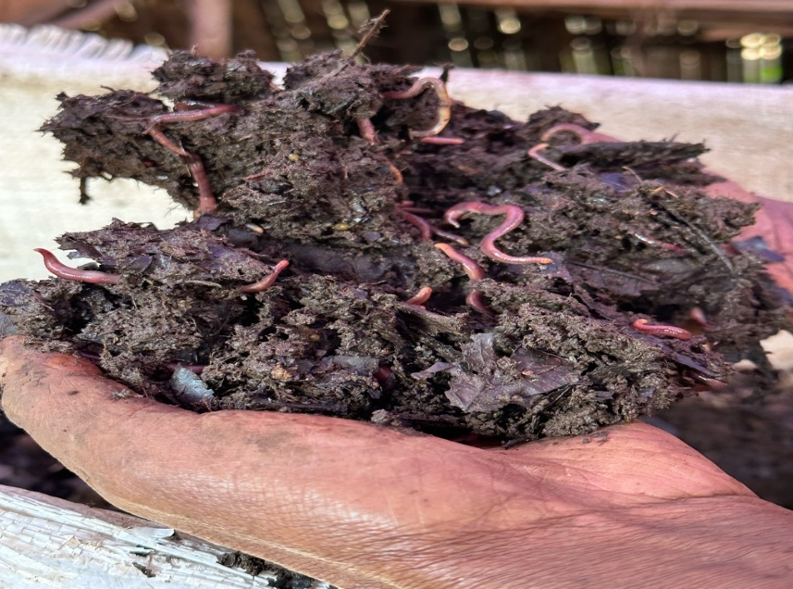
The mighty worm
Photo: worms used in vermiculture in Southern Ethiopia courtesy Tearfund Ireland Ethiopia

Slide 3
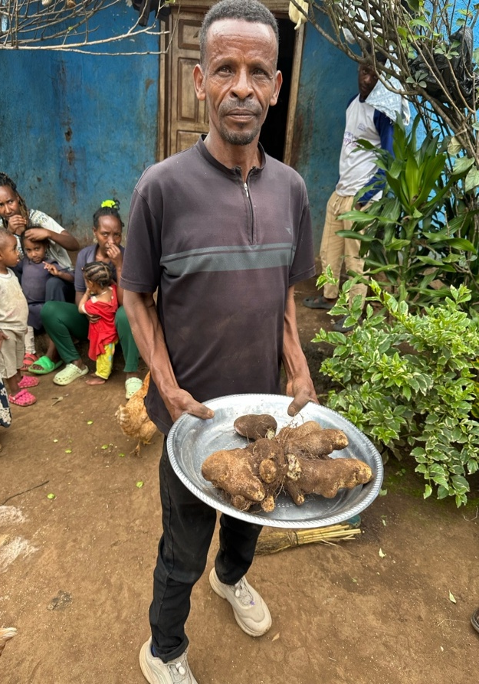
Meet Arba
Photo: Arba farmer Ethiopia showing some of his crop of yam grown using worm compost – credit Tearfund Ireland

Slide 4
Thank you
www.tearfund.ie

